Slide 1
CS312 Artificial Intelligence
Lecture # 13
HITEC University, Taxila
Mr. Mubashir Iqbal
Fall-2025

Slide 2
Lecture Content
MNIST Dataset
Convolutional Neural Networks (CNNs)
Recurrent Neural Networks (RNNs)
Sequence Modelling
Pre-trained Models
Transfer Learning

Slide 3
MNIST Dataset

Slide 4
MNIST Dataset
The MNIST dataset is a large collection of handwritten digit images used as a standard benchmark in machine learning and computer vision.
The name MNIST stands for Modified National Institute of Standards and Technology database. It was created by combining and preprocessing samples from the original NIST datasets to make them suitable for machine learning tasks.
It contains 70,000 images of handwritten digits (0–9):
60,000 images in the training set
10,000 images in the testing set (so models can be trained and then evaluated)
Each image is:
28 pixels wide and 28 pixels tall
Grayscale (values from 0 to 255 representing brightness)
Labeled with the digit it represents (0–9)

Slide 5
MNIST Dataset
Download Options
Kaggle: MNIST Dataset
CSV version (labels + pixel values): phoebetronic/mnist: Publicly available MNIST CSV dataset.
Hugging Face version: ylecun/mnist · Datasets at Hugging Face
How It’s Used in Python
from tensorflow.keras.datasets import mnist
(X_train, y_train), (X_test, y_test) = mnist.load_data()

Slide 6
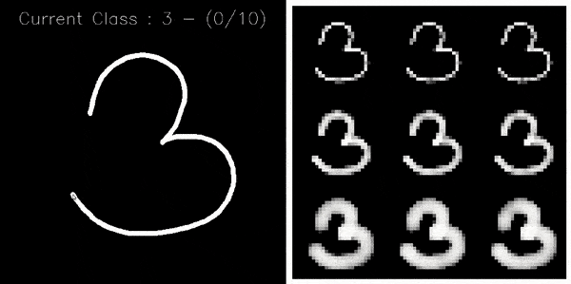
MNIST Dataset
Read Link: Classification · Davi Frossard
Online Testing: MNIST Image Classification - test online with Python and ConvNet. Valentyn Sichkar

Slide 7
Convolutional Neural Networks (CNNs)

Slide 8
Convolutional Neural Network (CNN)
A Convolutional Neural Network (CNN) is a deep learning architecture that uses convolution operations to automatically extract spatial features from images for classification and recognition tasks.
Convolution Operations: Convolution is a mathematical operation where a filter slides over data (like an image), multiplies corresponding values, and adds them up to produce a new result. It is commonly used to extract features or modify data in signal processing, image processing, and deep learning.
Spatial features: Spatial features are digital representations of real-world objects or phenomena defined by their location, shape, and geometric properties

Slide 9
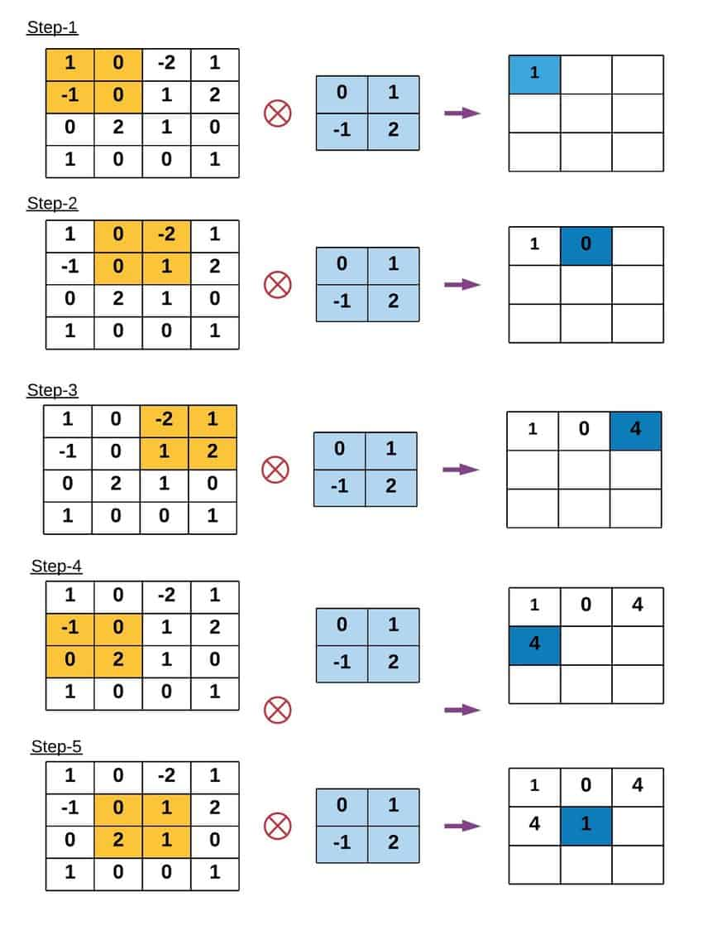
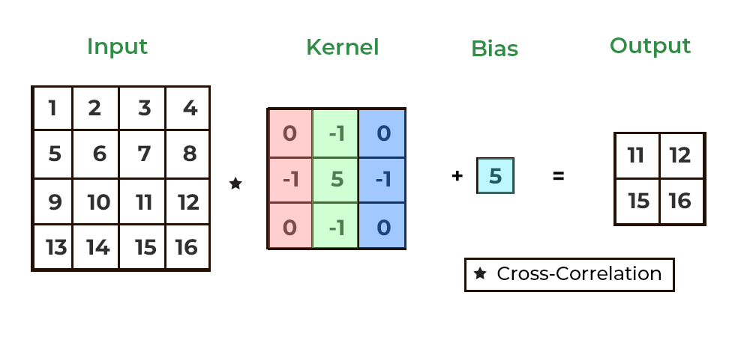
Convolutional Neural Network (CNN)
Convolution Operations:

Slide 10
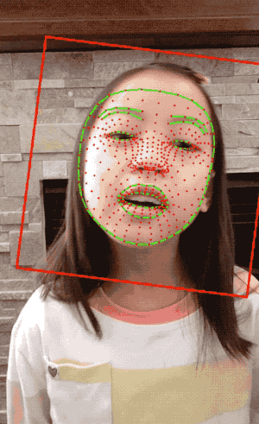
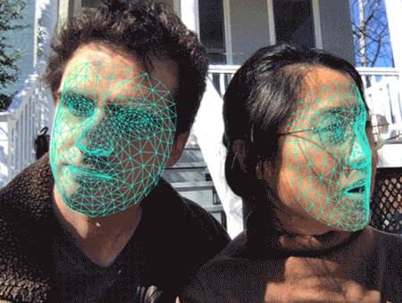
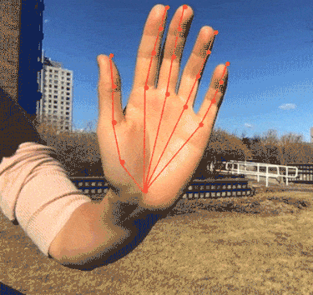
Convolutional Neural Network (CNN)
Spatial features: Spatial features are digital representations of real-world objects or phenomena defined by their location, shape, and geometric properties
Link: Face and hand tracking in the browser with MediaPipe and TensorFlow.js — The TensorFlow Blog

Slide 11
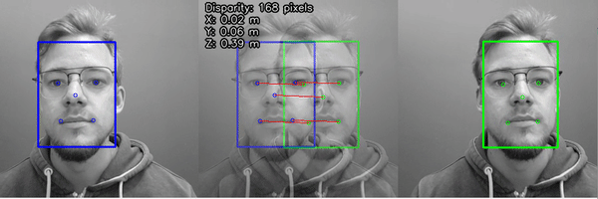
Convolutional Neural Network (CNN)
A Convolutional Neural Network (CNN) is a specialized type of Deep Learning model designed primarily to process visual data such as:
Images
Videos
Medical scans
Satellite images
Face images
Handwritten text
CNNs are inspired by the human visual system, where the brain processes visual information in layers, detecting edges first, then shapes, then objects.

Slide 12
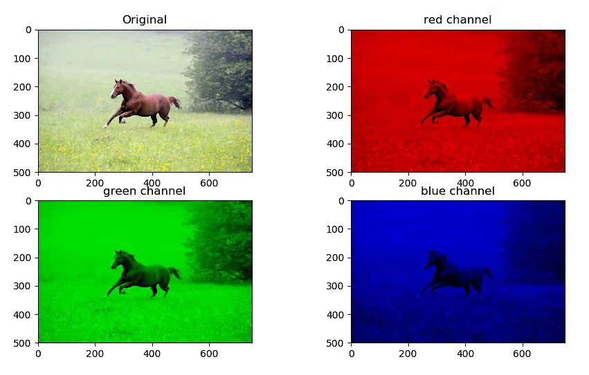
Convolutional Neural Network (CNN)
Traditional neural networks (MLP/ANN) treat input as flat data (1D vectors). But images are 2D or 3D structured data (height × width × channels).
CNNs:
Preserve spatial structure
Learn local patterns
Automatically extract features
Reduce computational cost
Improve accuracy

Slide 13
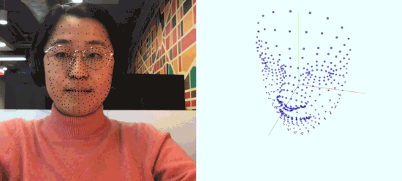
Basic Architecture of CNN
A CNN is built using the following main layers:
Input Layer
Convolution Layer
Activation Layer
Pooling Layer
Flattening Layer
Fully Connected Layer (Dense Layer)
Output Layer

Slide 14
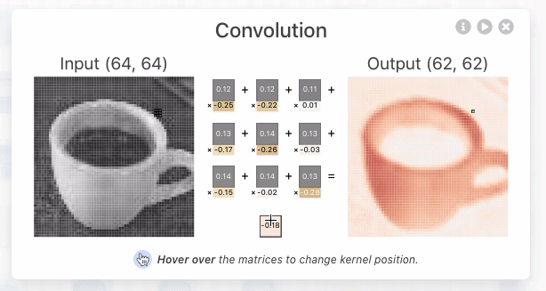
Basic Architecture of CNN
1. Input Layer
Takes the raw image as input.
Example:
Grayscale image → 28×28×1
RGB image → 224×224×3

Slide 15
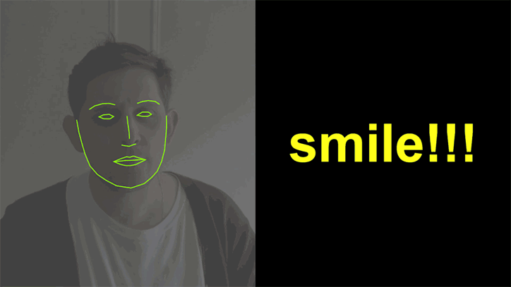
Basic Architecture of CNN
2. Convolution Layer (Core of CNN)
Applies filters (kernels) over the image.
Extracts important features like:
edges
corners
textures
patterns
shapes
Concept: A small matrix (filter) slides over the image and performs mathematical convolution.
Output: Feature maps

Slide 16
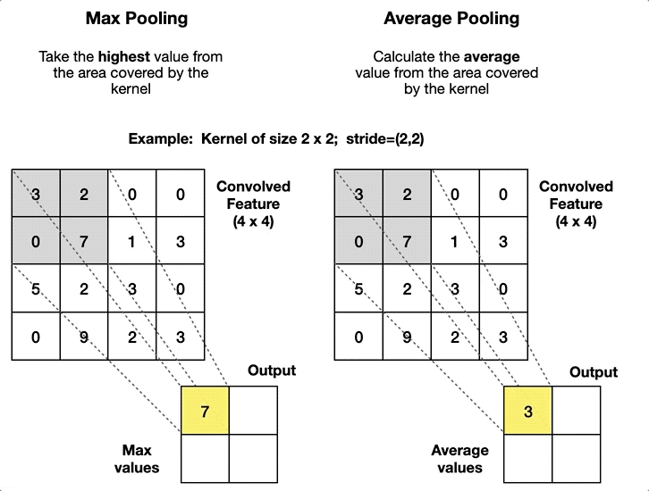
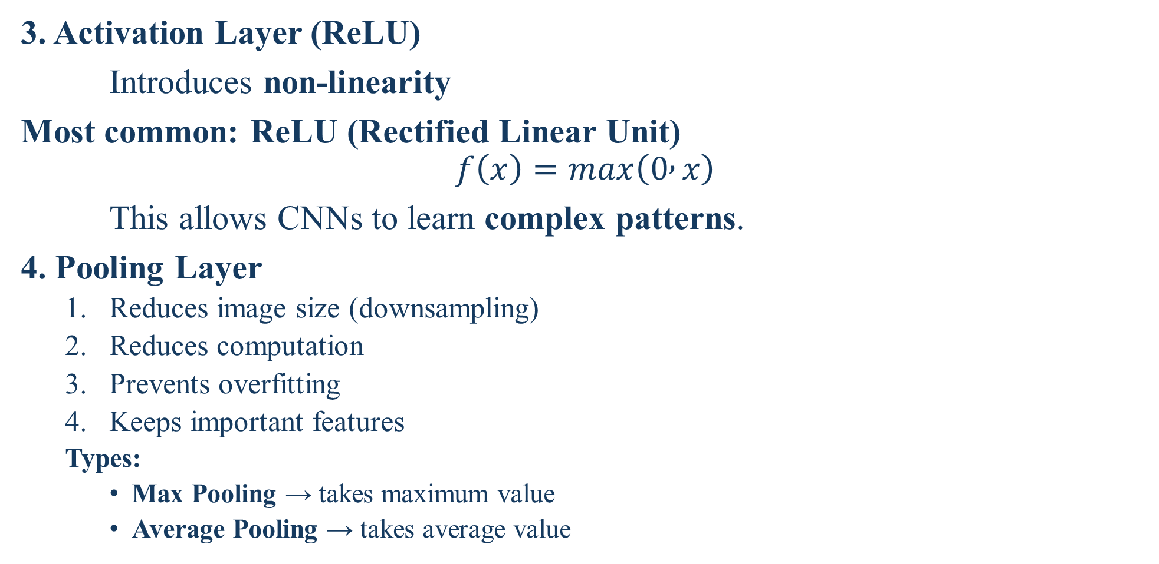
Basic Architecture of CNN
3. Activation Layer (ReLU)
Introduces non-linearity
Most common: ReLU (Rectified Linear Unit)
$$f\left(x\right)=max\left(0 , x\right)$$
This allows CNNs to learn complex patterns.
4. Pooling Layer
Reduces image size (downsampling)
Reduces computation
Prevents overfitting
Keeps important features
Types:
Max Pooling → takes maximum value
Average Pooling → takes average value
Notes:
Convolutional Neural Networks Explained - How To Successfully Classify Images in Python | Towards Data Science

Slide 17

Basic Architecture of CNN
5. Flattening Layer
Converts 2D feature maps into 1D vector
Makes data compatible with Dense layers
6. Fully Connected Layer (Dense Layer)
Performs final reasoning
Combines all extracted features
Learns decision boundaries
7. Output Layer: Depends on task:
Binary classification → Sigmoid
Multi-class classification → Softmax
Regression → Linear activation

Slide 18
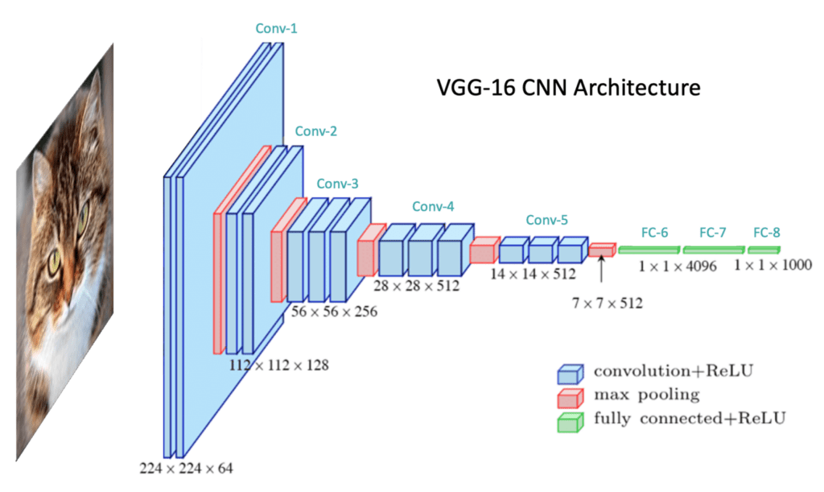
Convolutional Neural Network (CNN)
Link: Convolutional Neural Network: A Complete Guide

Slide 19
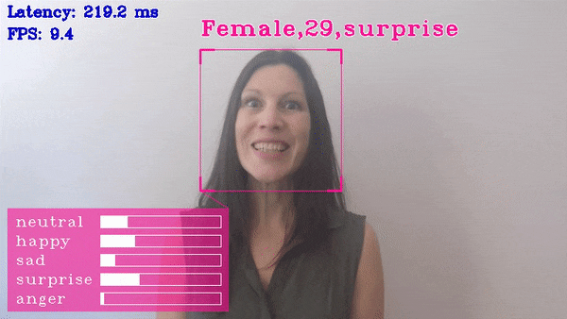
Convolutional Neural Network (CNN)
Applications of CNN
Face recognition
Medical diagnosis (MRI, X-ray analysis)
Autonomous vehicles
Object detection
Surveillance systems
Fingerprint recognition
OCR (Optical Character Recognition)
Emotion detection
Satellite image analysis

Slide 20
CNN vs ANN
ANN | CNN
Works on flat data | Works on structured image data
Manual feature extraction | Automatic feature extraction
High parameters | Fewer parameters
Not spatial-aware | Spatially aware
Low image accuracy | High image accuracy

Slide 21
Python CNN
from tensorflow.keras.models import Sequential
from tensorflow.keras.layers import Conv2D, MaxPooling2D, Flatten, Dense, Dropout
model = Sequential()
model.add(Conv2D(filters=32, kernel_size=(3,3), activation='relu', input_shape=(28,28,1))) # Convolution Layer 1
model.add(MaxPooling2D(pool_size=(2,2)))
model.add(Conv2D(filters=64, kernel_size=(3,3), activation='relu')) # Convolution Layer 2
model.add(MaxPooling2D(pool_size=(2,2)))
model.add(Flatten()) # Flatten Layer
model.add(Dense(128, activation='relu’)) # Fully Connected Layer
model.add(Dropout(0.3)) # Prevent overfitting
model.add(Dense(10, activation='softmax')) # 10 digits (0–9) # Output Layer
model.compile(optimizer='adam',loss='categorical_crossentropy’, metrics=['accuracy’]) #Compile Model
model.summary()

Slide 22
Recurrent Neural Networks (RNNs)

Slide 23
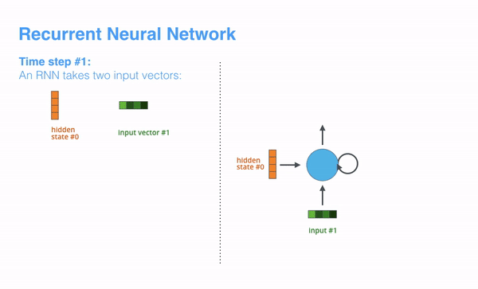
Recurrent Neural Networks (RNNs)
A Recurrent Neural Network (RNN) is a type of Deep Learning model specially designed to process sequential data — data where order and time matter. An RNN is a neural network that can remember previous inputs and use them to make better predictions on sequence data. Unlike traditional neural networks, RNNs have a memory mechanism, allowing them to remember previous inputs and use that information in future predictions.
Traditional ANN and CNN models:
Treat each input as independent
Have no memory
Cannot understand sequence relationships
RNNs:
Understand temporal relationships
Maintain context
Process time-dependent data

Slide 24
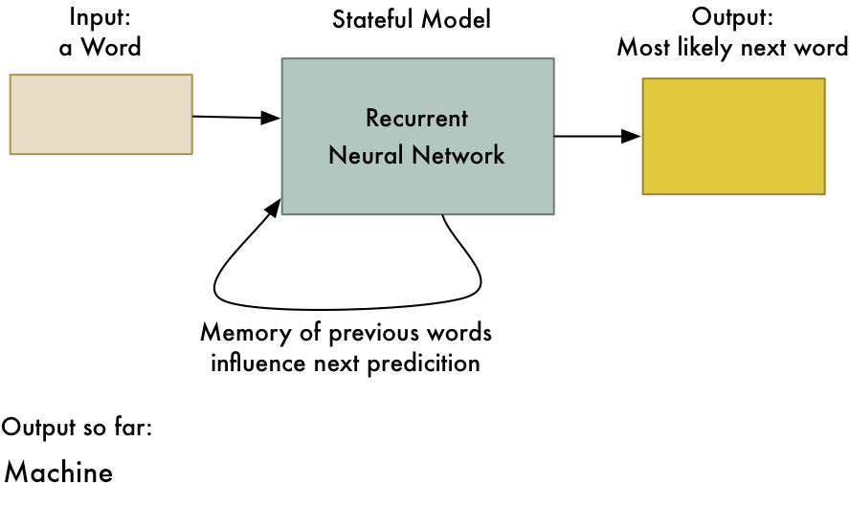
Recurrent Neural Networks (RNNs)
Types of Sequential Data: RNNs are used when data is ordered in time:
Text (sentences, paragraphs)
Speech/audio signals
Sensor data streams
Stock prices
ECG/EEG signals
Video frames
User behavior logs

Slide 25
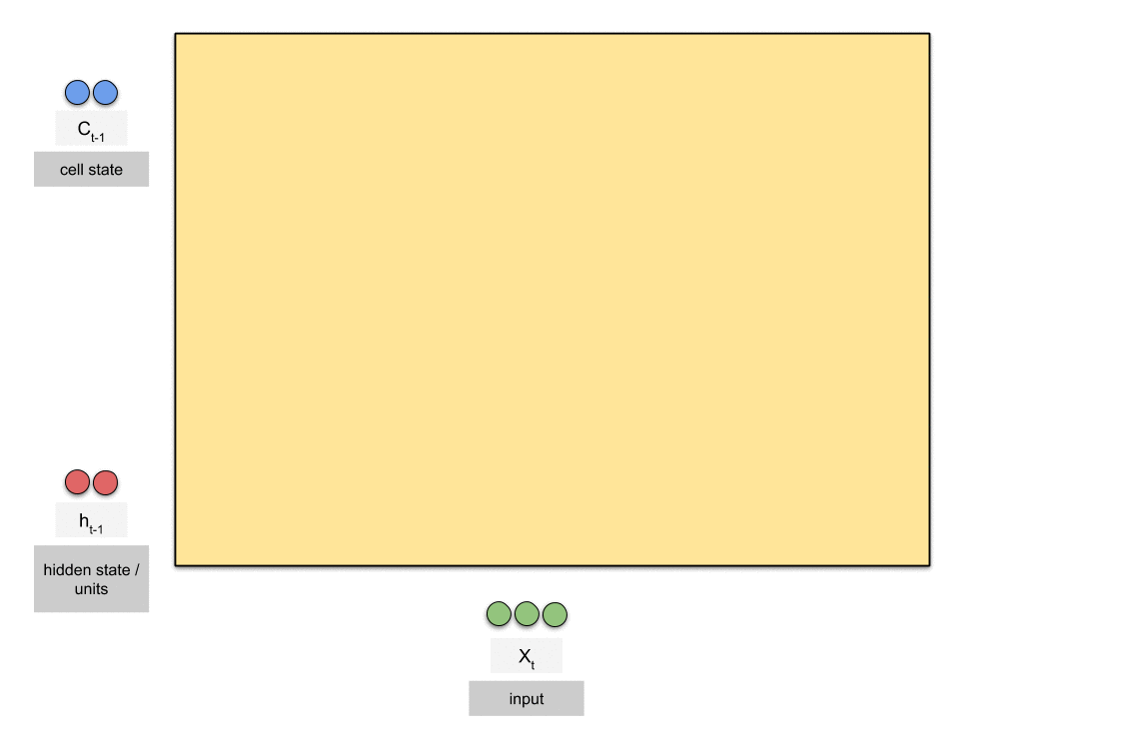
Recurrent Neural Networks (RNNs)
Core Idea of RNN: Each output depends on both:
the current input
the previous hidden state (memory)
This gives RNN the ability to remember past information.

Slide 26
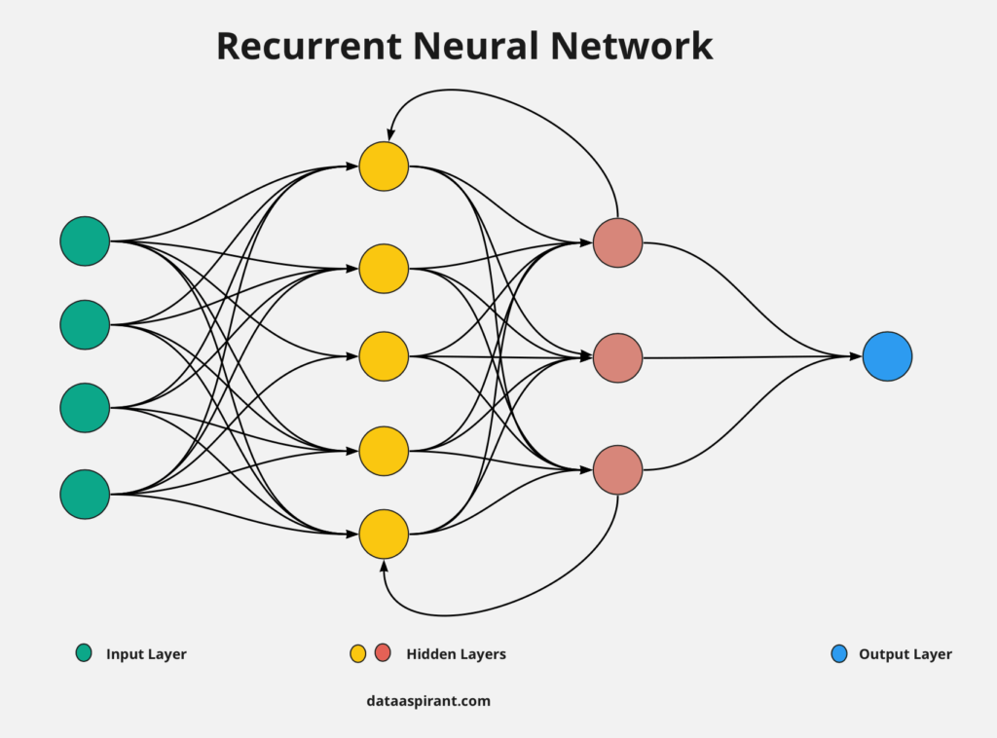
Basic Architecture of RNN
Components of an RNN
Input sequence
Hidden state (memory)
Recurrent connection
Weights
Activation functions
Output sequence
Types of RNN
One-to-One → Standard NN
One-to-Many → Image captioning
Many-to-One → Sentiment analysis
Many-to-Many → Language translation

Slide 27
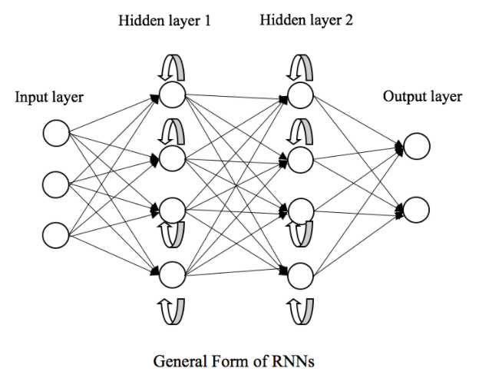
Recurrent Neural Networks (RNNs)
Applications of RNN
Speech recognition
Machine translation
Chatbots
Text generation
Sentiment analysis
Stock market prediction
Weather forecasting
Music generation
Video captioning
Human activity recognition

Slide 28
Python RNN
from tensorflow.keras.models import Sequential
from tensorflow.keras.layers import SimpleRNN, Dense, Dropout
model = Sequential()
model.add(SimpleRNN(
units=64, # Number of memory cells
activation='tanh', # Activation function
return_sequences=False, # Output only last time step
input_shape=(10, 5) # (timesteps, features)
))
model.add(Dense(32, activation='relu’)) # Fully Connected Layer
model.add(Dense(1, activation='softmax’))
model.compile(optimizer='adam',loss='categorical_crossentropy’, metrics=['accuracy’]) #Compile Model
model.summary()

Slide 29
Sequence Modelling

Slide 30
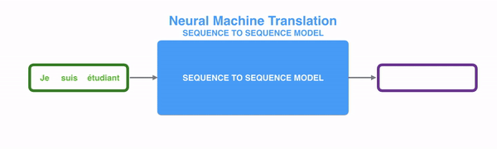
Sequence Modelling
Sequence modelling is the process of designing AI/ML models that can understand, learn from, and predict ordered data, where the sequence and timing of elements matter. In sequence data, order is meaningful — changing the order changes the meaning.
The value of a data point depends not only on itself, but also on previous data points.

Slide 31
Sequence Modelling
Examples of Sequence Data
Text → words in a sentence
Speech → audio signals over time
Stock prices → daily prices
Sensor data → time-based signals
ECG/EEG signals
DNA sequences
User activity logs
Video frames
Models Used for Sequence Modelling
RNN (Recurrent Neural Networks)
LSTM
GRU
Transformers
Hidden Markov Models (HMM)
Temporal CNNs
Attention Models

Slide 32
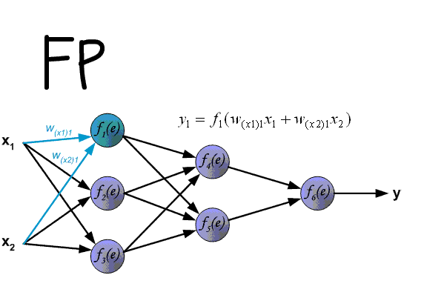
Sequence Modelling
Why Sequence Modelling is Important
Traditional ML models:
Treat data as independent samples
Ignore time/order
Fail to capture temporal patterns
Sequence models:
Learn dependencies
Capture context
Understand temporal relationships
Model cause-effect over time
Core Components of Sequence Modelling
Ordered input data
Temporal dependency
Memory mechanism
Context modeling
Sequential prediction
State transition

Slide 33
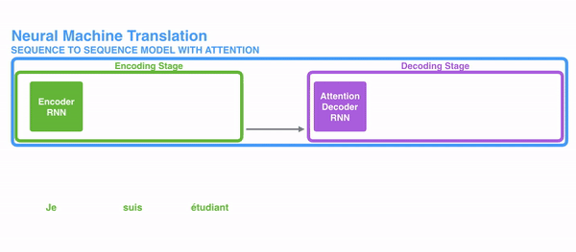
Sequence Modelling
Types of Sequence Modelling Tasks
1. Sequence-to-One
Input: sequence
Output: single value
Example: sentiment analysis
2. Sequence-to-Sequence
Input: sequence
Output: sequence
Example: translation
3. One-to-Sequence
Input: one input
Output: sequence
Example: image captioning

Slide 34
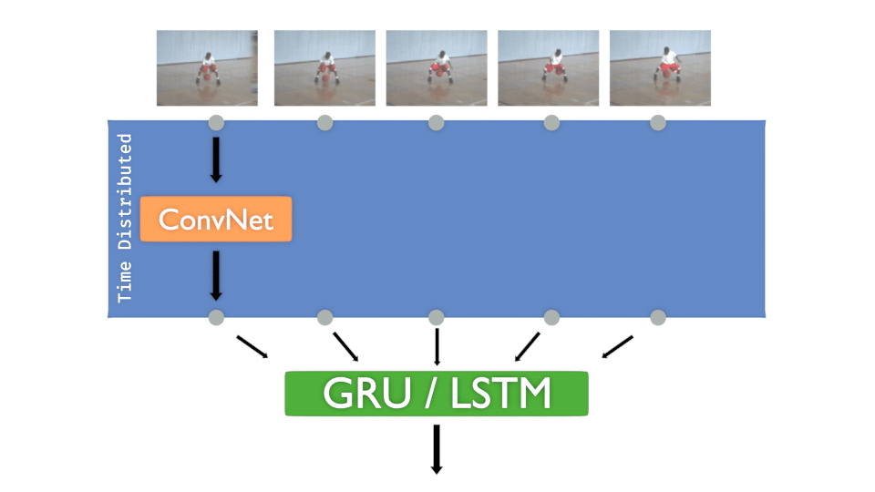
Sequence Modelling
Applications of Sequence Modelling
Language translation
Chatbots
Voice assistants
Stock forecasting
Weather prediction
Activity recognition
Medical diagnosis
Fraud detection
Recommendation systems
Autonomous driving

Slide 35
Pre-trained Models

Slide 36
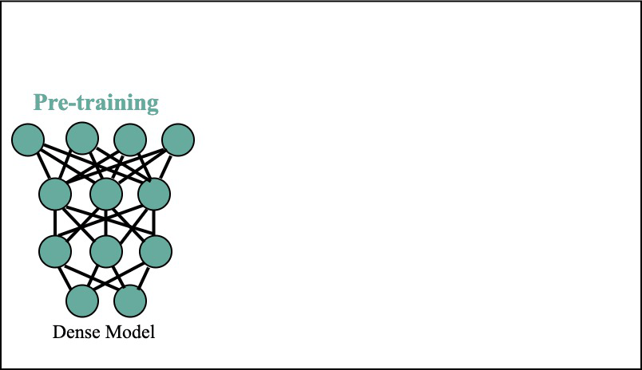
Pre-trained Models
A Pre-Trained Model is an AI model that has already been trained on a very large dataset and learned general patterns, features, and knowledge, which can later be reused for new tasks instead of training a model from scratch.
A pre-trained model is a ready-made AI model that has already learned from big data and can be reused for new tasks.
How Pre-Trained Models Work
Model is trained on large-scale dataset
Learns general features
Model is saved with learned weights
Reused for new tasks
Final layers are modified
Model is fine-tuned

Slide 37
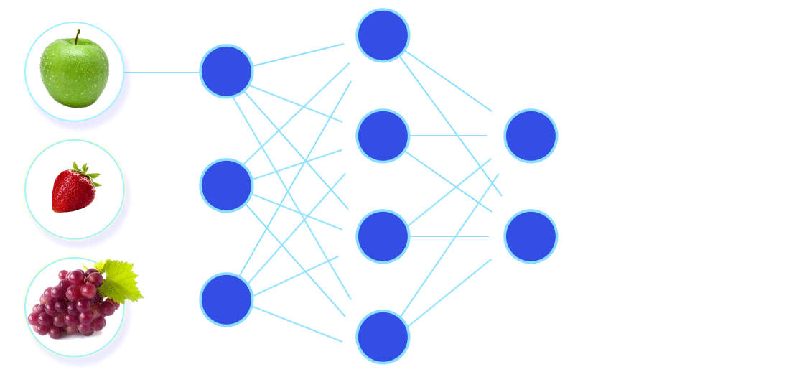
Pre-trained Models
Why Pre-Trained Models are Important
Training deep models from scratch requires:
Huge datasets
Expensive hardware (GPU/TPU)
Long training time
High financial cost
Complex tuning
Pre-trained models solve this by:
Saving time
Reducing cost
Improving accuracy
Reducing data needs
Enabling faster development
Making AI accessible

Slide 38
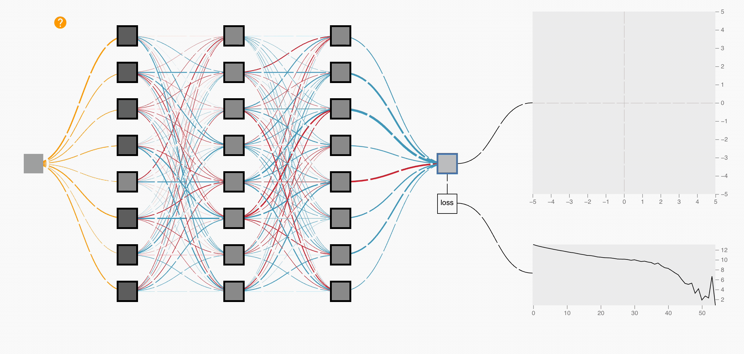
Pre-trained Models
Pre-trained models are the foundation of transfer learning.
Pre-trained model = knowledge source
Transfer learning = knowledge reuse process
What Knowledge is Stored
Visual patterns (edges, shapes, textures)
Language structure
Grammar and syntax
Semantics
Context understanding
Object relationships
Temporal patterns
Representations

Slide 39
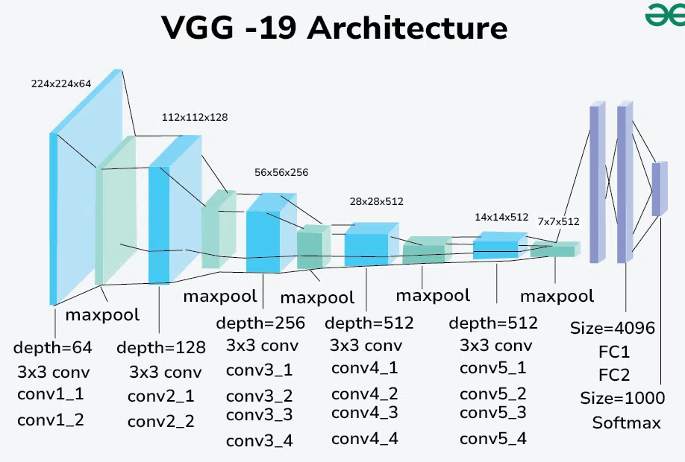
Pre-trained Models
1. Computer Vision Models:
VGG16 / VGG19
ResNet
Inception
MobileNet
EfficientNet
YOLO
SSD
Applications:
Face recognition
Medical imaging
Disease detection
Autonomous driving
CCTV surveillance
Traffic monitoring
OCR
Defect detection in industry

Slide 40
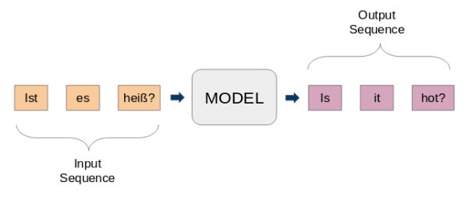
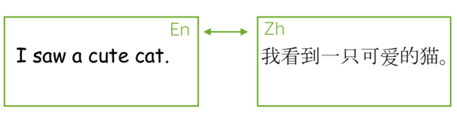
Pre-trained Models
2. Natural Language Processing (NLP) Models:
BERT
GPT
RoBERTa
T5
XLNet
Word2Vec
GloVe
Applications:
Chatbots
Machine translation
Text summarization
Sentiment analysis
Question answering
Document classification
Voice assistants
Search engines

Slide 41
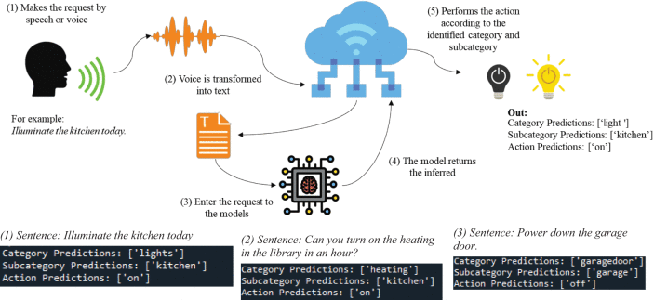
Pre-trained Models
3. Speech Processing Models:
DeepSpeech
Wav2Vec
Speech2Text models
Applications:
Speech recognition
Voice assistants
Call center automation
Transcription systems
Smart devices
Voice authentication

Slide 42
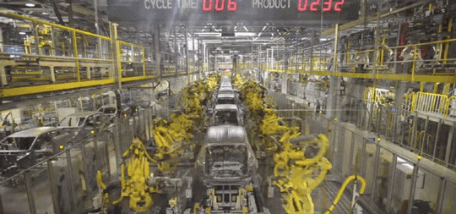
Pre-trained Models
4. Robotics Models:
Pretrained vision models
Pretrained navigation models
Reinforcement learning policies
Applications:
Object grasping
Path planning
Obstacle avoidance
Human-robot interaction
Industrial automation

Slide 43
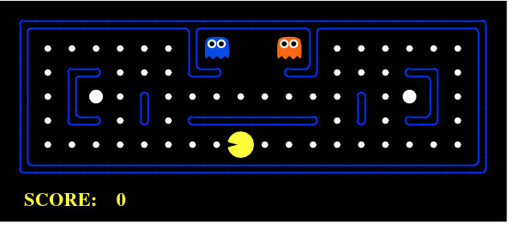
Pre-trained Models
5. Reinforcement Learning Models:
Pretrained policies
Deep Q-Networks (DQN)
AlphaZero-style models
Applications:
Game playing AI
Robotics control
Traffic control
Smart grids
Resource optimization

Slide 44
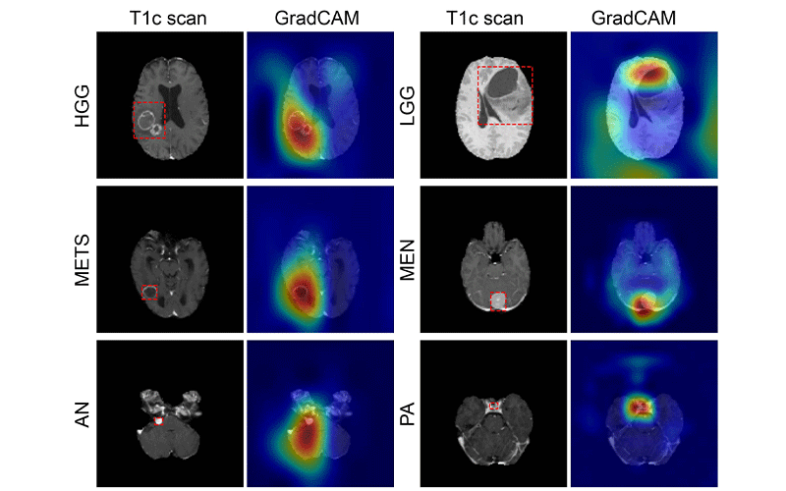
Pre-trained Models
6. Healthcare AI Models:
Medical imaging CNNs
Clinical NLP models
Diagnostic DL models
Applications:
Cancer detection
X-ray analysis
MRI analysis
ECG interpretation
Disease prediction
Patient monitoring

Slide 45
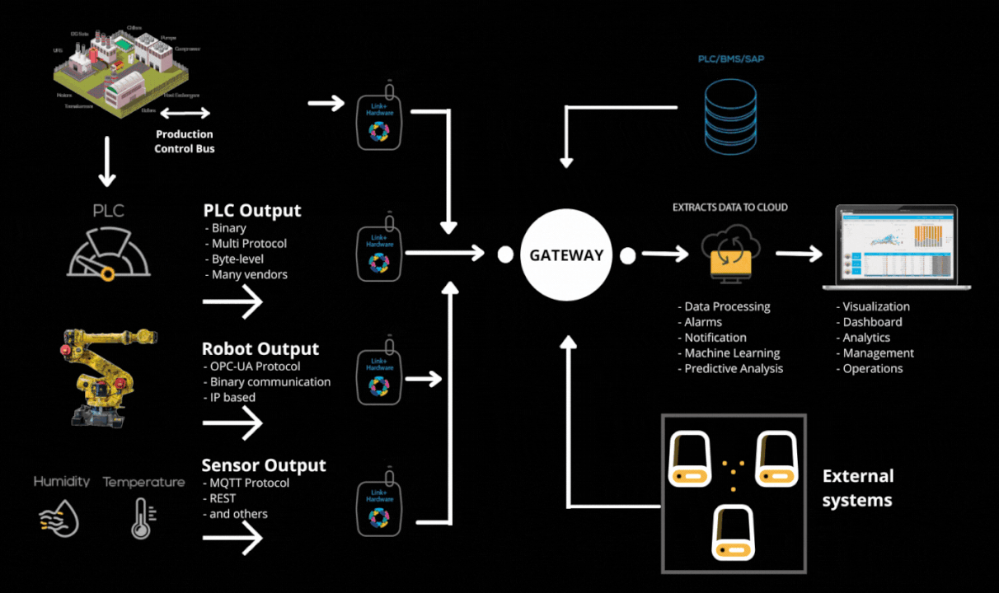
Pre-trained Models
7. Finance AI Models:
NLP models
Fraud detection models
Time-series models
Applications:
Fraud detection
Risk analysis
Stock prediction
Credit scoring
Customer profiling

Slide 46
Transfer Learning

Slide 47
Transfer Learning
Transfer Learning is a deep learning technique where a model trained on one large problem is reused and adapted to solve a different but related problem.
Instead of training a model from scratch, we transfer knowledge from an already trained model.
Knowledge learned from one task can help solve another task faster and better.
How Transfer Learning Works
A model is trained on a large dataset (e.g., ImageNet, Wikipedia text, Common Crawl)
The learned features are stored in the model weights
The model is reused for a new task
Final layers are modified
The model is fine-tuned

Slide 48
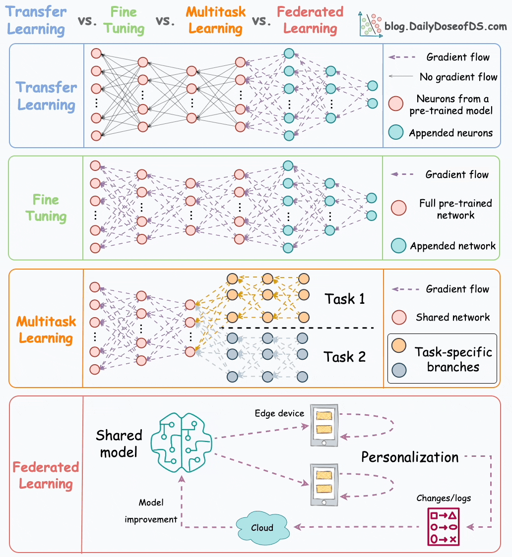
Transfer Learning
Read Link: Transfer Learning vs. Fine-tuning vs. Multitask Learning vs. Federated Learning

Slide 49
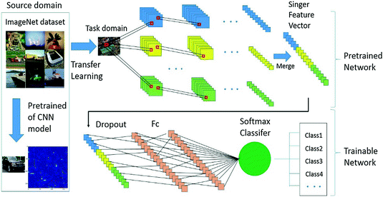
Transfer Learning
Why Transfer Learning is Needed
Training deep models from scratch requires:
Huge datasets
Large compute power (GPUs/TPUs)
Long training time
High cost
Expert-level tuning
Transfer learning solves this by:
Reusing learned features
Reducing training time
Improving accuracy
Reducing data requirements
Lowering computational cost

Slide 50
Transfer Learning
Types of Transfer Learning
1. Feature Extraction
Freeze base model layers
Train only new classifier layers
2. Fine-Tuning
Unfreeze some layers
Retrain with small learning rate

Slide 51
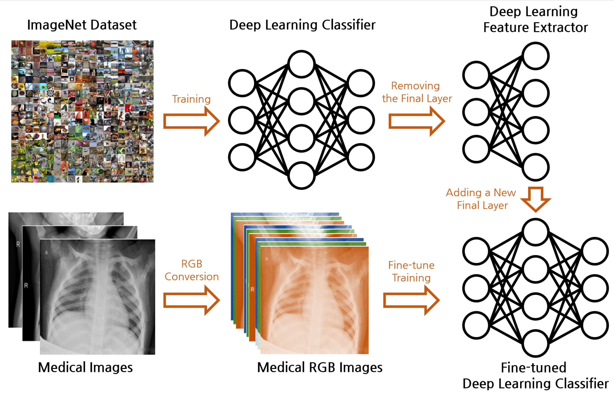
Transfer Learning
Applications
Face recognition
Medical imaging
Satellite imaging
Speech recognition
Emotion detection
Document classification
Chatbots
Recommendation systems

Slide 52
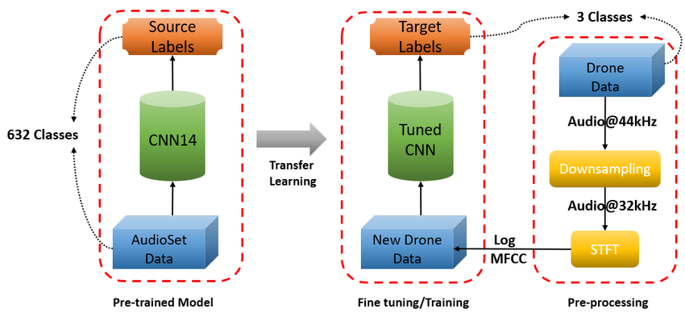
Transfer Learning
Advantages
Faster training
Better accuracy
Less data required
Reduced overfitting
Lower cost
Better generalization
Limitations
Domain mismatch problem
Negative transfer risk
Overfitting small datasets
Model size issues
Bias transfer

Slide 53

Recap
MNIST Dataset
Convolutional Neural Networks (CNNs)
Recurrent Neural Networks (RNNs)
Sequence Modelling
Pre-trained Models
Transfer Learning

Slide 54

Not included in Syllabus
If you were taking a nap, wake up… the Semester is over!

